Slide 1
Export Compliance Executive-level Overview of ITAR, EAR, & Related NOAA Policy for All NESDIS Employees
Richard Fulton
NESDIS Controlled Technology Coordinator
SSMC1, Silver Spring, MD
7/17/2013

Slide 2
Export Compliance
It’s serious business
It’s not a squeaky wheel
You often don’t know of problems until something goes wrong…then it’s too late for the easy fix
Failure to understand and comply with export control laws not only jeopardizes national security interests, it can also result in severe penalties for NOAA & the person who exports improperly
monetary fines and/or prison time

Slide 3
Governing Federal Regulations
International Traffic in Arms Regulations (ITAR)
Protects key U.S. defense-related technology (including weather satellites) from foreign access
22 Code of Federal Regulations Chapter I, Subchapter M, Parts 120-130
U.S. regulation/licensing authority: Department of State’s Directorate of Defense Trade Controls (DOS/DDTC)
http://www.pmddtc.state.gov/regulations_laws/itar_official.html
Export Administration Regulations (EAR)
Protects key commercial-application technology from foreign access
15 CFR Parts 730-774
U.S. regulation/licensing authority: Department of Commerce’s Bureau of Industry & Security (DOC/BIS)
http://www.bis.doc.gov/policiesandregulations/ear/index.htm

Slide 4
Governing NOAA & NESDIS Policy
NOAA Administrative Order 207-12 “Technology Controls and Foreign National Access” (2006)
Policy mandates quarterly monitoring, control, and reporting by each NOAA Line Office
http://www.corporateservices.noaa.gov/ames/administrative_orders/chapter_207/207-12.html
NESDIS Policy
Describes roles & responsibilities of persons designated to maintain compliance…and process for review of potential export actions
http://deemedexports.noaa.gov/roles_&_responsibilities/index.html
Controlled Technology Coordinator (CTC – R. Fulton) and Deputy CTC (M. Medina)
16 Export Control Points of Accountability (POAs) at each of our NESDIS facilities
OSPO@NSOF – K. Hampton
OSPO@NCWCP – K. Hampton
OSPO@FCDAS – L. Ledlow
OSPO@WCDAS – B. Clark
HQ-OCIO – R. Fulton
NCDC – A. Annis
NGDC – M. Moran
NODC@SSMC3 – D. Bridgett
NODC-NCDDC – J. Sandidge
STAR@NCWCP – G. Taylor
STAR@M-Square – C. Cao
STAR@CIRA – M. DeMaria
STAR@CIMSS – J. Key
JPSS – J. Furgerson
GOES-R – C. Keeler
OSD@NSOF – W. Dorsey
OSD@SSMC1 – R. Fulton
IIA – M. Medina

Slide 5
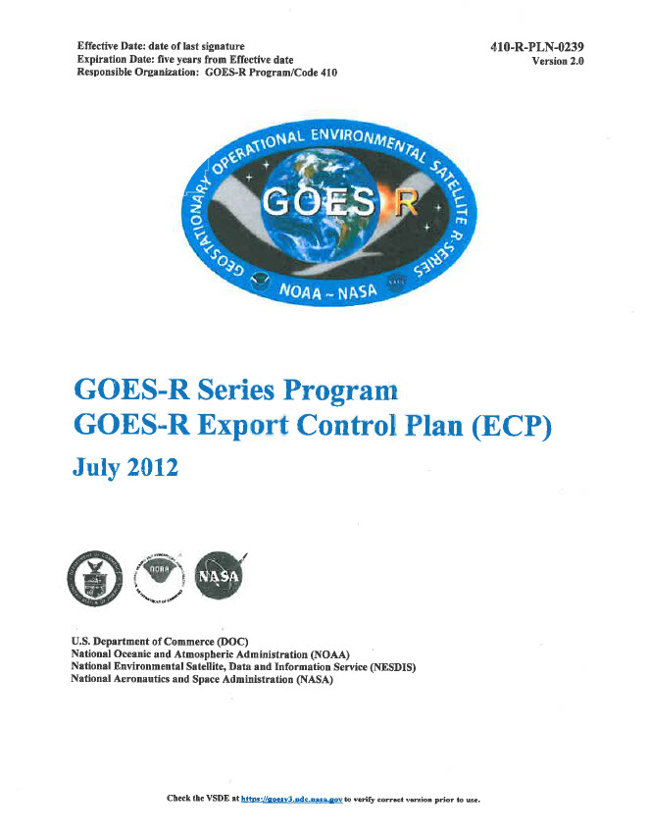
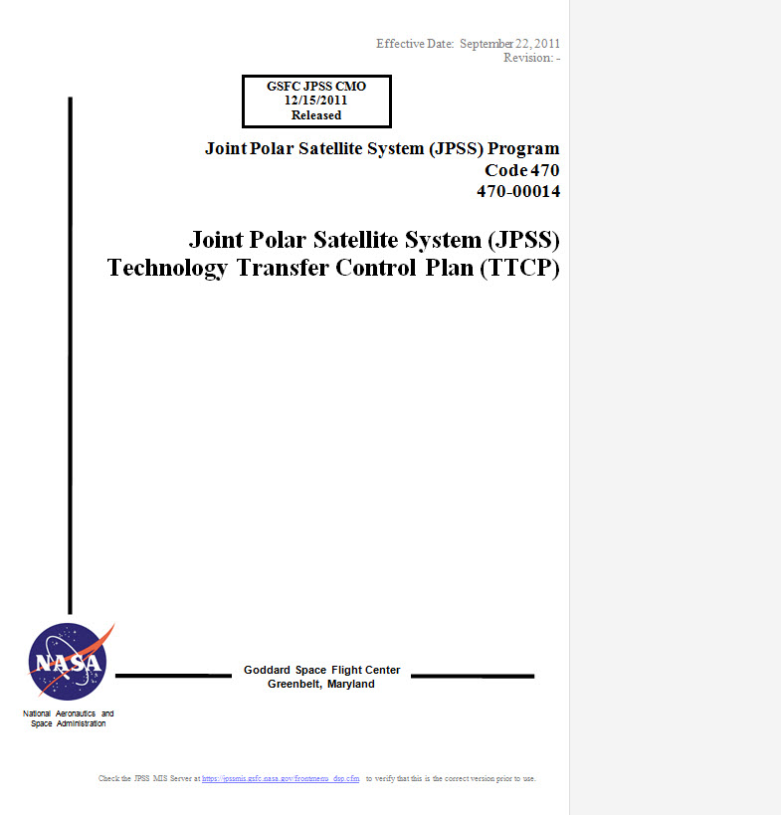
Examples of Program-level Export Control Plans
GOES-R Program
JPSS Program

Slide 6
NAO 207-12 “Technology Controls & Foreign National Access”
Requires routine monitoring & updates to:
Controlled Technology Inventories
Foreign National guest lists
Access Control Plans
Access Control Information Sheets
Requires annual NESDIS certification of export compliance by the DAA
Defines required process for hosting & pre-approval of foreign national visitors & guests who wish to come to NESDIS facilities

Slide 7
Foreign National (FN) Approval Processing to Visit NESDIS Facilities
All FNs must be preapproved in advance by NESDIS, NOAA, and DOC Security
Find instructions and forms at http://deemedexports.noaa.gov/compliance_access_control_procedures/how-to-sponsor-a-foreign-national-at-a-noaa-facility.html
Foreign national “guests” (staying > 3 days)
Submit at least 30 days in advance to your POA for review, then to NESDIS CTC, NOAA OCAO, DOC Security
Foreign national “visitors” (< 4 days)
Submit visitor information direct to DOC Security at least 1 day in advance
Submit FN information form securely to DOC Security (contains PII)

Slide 8
Who is Responsible for Export Control in NOAA?
Front line of defense = YOU
Every federal employee and on-site contractor
Second line of defense = Export Control Points of Accountability (POA) (see slide 4)
Manages office/center/program-level compliance activities
Third line of defense = NESDIS Controlled Technology Coordinator (CTC) and Deputy CTC
Manages NESDIS-level compliance activities
NESDIS Export Control Empowered Official
Deputy Assistant Administrator
NOAA Office of the Chief Administrative Officer
Manages NOAA-level export policy & compliance activities

Slide 9
Everyone’s Responsibilities (feds & on-site contractors)
Protect ALL ITAR/EAR controlled technology in your possession from foreign national access (includes electronic computer files)
Report all ITAR/EAR materials in your possession to your office’s POA (see slide 4) for inclusion in NESDIS’s inventory
Describe this technology and your access controls in writing…give form to your POA for recording
If there are status changes, report it to your POA immediately

Slide 10
What is an “Export”?
An export is a shipment or transmission of controlled items to a foreign person out of the United States
Notes:
Definition of US in Part 772: United States. Unless otherwise stated, the 50 States, including offshore areas within their jurisdiction pursuant to section 3 of the Submerged Lands Act (43 U.S.C. 1311), the District of Columbia, Puerto Rico, and all territories, dependencies, and possessions of the United States, including foreign trade zones established pursuant to 19 U.S.C. 81A-81U, and also including the outer continental shelf, as defined in section 2(a) of the Outer Continental Shelf Lands Act (43 U.S.C. 1331(a))

Slide 11
What is a “Deemed Export”?
The release of controlled technology to a foreign person in the US. It is deemed to be an export to the recipient’s home country.
Technology or source code
Notes:
Definition of US in Part 772: United States. Unless otherwise stated, the 50 States, including offshore areas within their jurisdiction pursuant to section 3 of the Submerged Lands Act (43 U.S.C. 1311), the District of Columbia, Puerto Rico, and all territories, dependencies, and possessions of the United States, including foreign trade zones established pursuant to 19 U.S.C. 81A-81U, and also including the outer continental shelf, as defined in section 2(a) of the Outer Continental Shelf Lands Act (43 U.S.C. 1331(a))

Slide 12
What Form Does Controlled Technology Take?
Tangible items
Hardware, satellite instruments, test equipment, hard copy engineering documents, CDs, DVDs, etc.
Soft items
Software, electronic files, etc.
Services
Discussions & meetings (formal & informal) with foreign nationals via phone, email, in-person, etc.
Training activities

Slide 13
Examples of ITAR/EAR Markings on Documents
“ITAR CONTROLLED DOCUMENT – DO NOT EXPORT – This document contains technical data as defined in ITAR Part 120.10 and thus is controlled by the U.S. Department of State”
“COMMERCE DESTINATION CONTROL STATEMENT - The export of these commodities, technology or software are subject to the U.S. Export Laws and Regulations in accordance with the Export Administration Regulations. Diversion contrary to U.S. law is prohibited.”
Usually appears on title page but may be on internal pages too
If ITAR/EAR markings appear just on the document title page, assume the entire document is controlled and do not share all or part of it with non-licensed foreign nationals

Slide 14
Possible Ways to Improperly Export Controlled Technology
International cooperative research, development, & manufacturing projects (even domestic ones)
Foreign students or professors conducting research in U.S. with NOAA scientists and engineers
Technical conferences or meetings open to the public (where access is not controlled or monitored)
Hosting a foreign national guest at a NOAA facility
NESDIS hosts about 100 FN contractors each year, mostly in STAR & NGDC
Tours of NOAA facilities

Slide 15
What is a Foreign Person?
Person with non-U.S. citizenship, including dual nationals of U.S.
Not a Permanent Resident Alien in the U.S.
i.e., Not “Green Card” holders
Foreign persons are prohibited from accessing ITAR or EAR materials without a USG-approved license

Slide 16
International Traffic in Arms Regulations
What is controlled by ITAR?
All items on the U.S. Munitions List (USML)

Slide 17
ITAR’s U.S. Munitions List (USML – 121.1) (1 of 2)
Category I: Firearms, Close Assault Weapons and Combat Shotguns
Category II: Guns and Armament
Category III: Ammunition/Ordnance
Category IV: Launch Vehicles, Guided Missiles, Ballistic Missiles, Rockets, Torpedoes, Bombs and Mines
Category V: Explosives and Energetic Materials, Propellants, Incendiary Agents and Their Constituents
Category VI: Vessels of war and Special Navel Equipment
Category VII: Tanks and Military Vehicles
Category VIII: Military Aircraft and Associated Equipment
Category IX: Military Training equipment and Training
Category X: Protective Personnel Equipment and Shelters
Category XI: Military Electronics
Category XII: Fire Control, Range Finder, Optical and Guidance and Control Equipment

Slide 18
ITAR’s U.S. Munitions List (USML – 121.1) (2 of 2)
Category XIII: Auxiliary Military Equipment
Category XIV: Toxicological Agents, Including Chemical Agents, Biological Agents and Associated Equipment
Category XV: Spacecraft Systems and Associated Equipment
Category XVI: Nuclear Weapons, Design and Testing Related Items
Category XVII: Classified Articles, Technical Data and Defense Services Not Otherwise Enumerated
Category XVIII: Directed Energy Weapons
Category XIX: reserved
Category XX: Submersible Vessels, Oceanographic and Associated Equipment
Category XXI: Miscellaneous Articles

Slide 19
Category XV – Spacecraft Systems and Associated Equipment
You can find NESDIS satellites here (for the near-term)….
“Spacecraft, including communications satellites, remote sensing satellites, scientific satellites, research satellites, navigation satellites, experimental and multi-mission satellites”
“Ground control stations for telemetry, tracking, and control of spacecraft or satellites”
“All specifically designed or modified systems or subsystems, components, parts, accessories, attachments and associated equipment….including ground support equipment, test equipment….”
“Technical data and defense services…as well as detailed design, development, manufacturing or production data for all spacecraft and specifically designed or modified components for all spacecraft systems”

Slide 20
Important ITAR Terms
Defense Article (120.6)
Any item or technical data* designated in the USML
This includes technical data recorded or stored in any physical form; models, mock-ups or other items that reveal technical data directly relating to items designated
Defense Service (120.9)
The furnishing of technical data or assistance (including training) to foreign persons, whether in the United States or abroad, in the design, development, engineering, manufacture, production, assembly, testing, repair, maintenance, modification, operation, demilitarization, destruction, processing or use of defense articles
* See definition next slide

Slide 21
Important ITAR Terms (cont.)
“Technical Data” (120.10)
Information which is required for the design, development, production, manufacture, assembly, operation, repair, testing, maintenance or modification of defense articles. This includes information in the form of blueprints, drawings, photographs, plans, instructions and documentation
Software directly related to defense articles (121.8)
System functional design, logic flow, algorithms, application programs, operating systems and support software for design, implementation, test, operation, diagnosis and repair

Slide 22
What is Not Controlled? (applies to both ITAR & EAR)
Public domain information – that which is published and which is generally accessible or available to the public, including
Fundamental research published in journals
Periodicals, books at libraries
Information released after approval by the cognizant USG agency
General scientific or engineering principles
Basic non-technical marketing information
General non-technical system descriptions
Financial information
Business terms and conditions

Slide 23
Export Licenses and Agreement
An export license from [DOS/DDTC, DOC/BIS] is the legitimate mechanism to export [ITAR, EAR]-controlled technology to a foreign country
NESDIS international agreements often specify license-like export terms & conditions with our partners
Licenses for NESDIS to export do not generally flow down to our support contractors…contractors are responsible for their own compliance
Licenses must be applied for by the exporter in advance, fully documented (who, what, when, why, how much), and are often approved with “provisos” (limitations on the transaction)
Licenses generally apply to exporting tangible items
Technical Assistance Agreements (TAAs) are licenses to provide technical services to foreign countries
This is usually a contractor-only authorization

Slide 24
Is an ITAR License Required?
Ask yourself: Is this item a defense article or service listed in the ITAR’s U.S. Munitions List?
If yes, a license is required to export anywhere outside the U.S.
Unless “exemptions” are available (see next slide)
If no, is it subject to another export jurisdiction, e.g., EAR?
Ask your NESDIS Export Control POA
They are trained to interpret regulations and classify items
Ask DOS/DDTC
Submit a “commodity jurisdiction” request

Slide 25
ITAR License Exemptions
Exemption = authorization to export without a license based on specific conditions…
Technical data exports by USG Agencies (125.4.b.3 and 125.4.b.13):
“Technical data in furtherance of a contract between the exporter and an agency of the USG if the contract provides for the export of the data and such data does not disclose the details of design, development, production, or manufacture of any defense article.”
“Technical data approved for public release by the cognizant USG department. It does not require that the information be published in order to qualify for the exemption.”
Shipments by or for USG Agencies (126.4):
“A license is not required for the temporary import, or temporary export, of any defense article, including technical data or the performance of a defense service, by or for any agency of the USG for official use by such an agency, or for carrying out any foreign assistance, cooperative project or sales program authorized by law and subject to control by the President by other means.”

Slide 26
Export Administration Regulations
What is “subject to the EAR”?
ALL items in the U.S. on the Commerce Control List (CCL) except:
Publicly available technology and software (734.7)
Products of fundamental research (734.8)
Literary non-technical publications such as newspapers or literary works available at libraries
Items subject to other control jurisdictions (e.g., ITAR)
Broad jurisdiction BUT… narrow license requirements

Slide 27
Export Administration Regulations
What is controlled by EAR (i.e., what needs a license to export)?
Technology that is required for the development, production, or use of items on the Commerce Control List (CCL)
“Dual use” items (have both commercial and military applications)
Items are controlled based on what country they will be exported to (in contrast to ITAR)

Slide 28
Commerce Control List (CCL)
Contains lists of those items subject to the licensing authority of DOC/BIS
Similar concept to the USML for ITAR
Most items are described in terms of their technical parameters
Each list entry has a unique Export Control Classification Number (“ECCN”)
Characterizes the nature of the controlled technology as a unique 5-character string (e.g., “0A018”)

Slide 29
Major Categories of the CCL

Slide 30
Product Groups of the CCL (sub-categories of previous page)

Slide 31
How Can You Determine the ECCN Number for an Item?
Ask the manufacturer
Self classify
Working with an engineer who knows the item & your POA, review the CCL together
Ask your NESDIS Export Control POA
They are trained on processes to classify items, but they can’t do it without your assistance
Ask DOC/BIS for a formal classification if it’s not obvious from the above (~10 days)

Slide 32
EAR Exceptions (Part 740)
Exception = authorization to export without a license based on certain specific conditions…
Some examples
GOV (740.11)
Overseas shipments to USG employees, either military or civilian
TMP (740.9)
Items for use up to 1 year

Slide 33
In summary…..Export Don’ts
Don’t export or re-export from the U.S. any USML-listed defense article or technical data or furnish any defense technical services without obtaining required license or written approval from the Department of State
Don’t export or re-export from the U.S. any CCL-listed commercial or dual-use item without a required license from the Department of Commerce
Don’t violate any of the terms or conditions of licenses or approvals granted by the DOC or DOS
Don’t export controlled technology without verifying the recipient is BOTH licensed and has a legitimate need to know

Slide 34
Export Don’ts (cont.)
Don’t transmit technical data using ANY transfer method (voice, email, mail, etc.) to foreign persons without a proper authorization
Don’t leave any export controlled items laying around on your desk or otherwise unprotected
Don’t put export controlled e-documents on unprotected NESDIS computers or public web sites where FNs have unrestricted access
Resulted in NESDIS’s first ever ITAR violation in early 2013
Don’t email it around unsecurely

Slide 35
Export Do’s
Do protect all controlled technology in your possession from FN access
Lock it up in file cabinets
Lock your computer when you step away
Do report it to your office’s POA to verify proper controls are in place and to add it to NESDIS’s Controlled Technology Inventory
Do document how it’s being protected in coordination with your office’s POA
If you don’t know whether it’s controlled or not, contact your office’s POA for an assessment
Do get clearance from your POA before publishing, distributing, or presenting technical information in open meetings or teleconferences

Slide 36
Export Do’s (cont.)
Do follow all export control warning markings on documents
If it’s marked, protect it
Do abide by any export requirements & limitations specified in
NESDIS satellite program Export Control Plans,
support contract clauses, and/or
International Agreements (e.g., “Transfer of Goods & Technical Data Clause”)
Do get ITAR/EAR-trained if you deal with technology in international programs/projects
Do contact your NESDIS office’s POA (see slide 4) if you have further questions

Slide 37
Obama Administration’s Export Control Reform
Major changes are coming for NESDIS in the next year…stay tuned
Plans are to move weather satellites from USML (ITAR) to CCL (EAR)
Will likely ease control restrictions
However…controls will NOT totally go away for NESDIS satellite technology

Slide 38
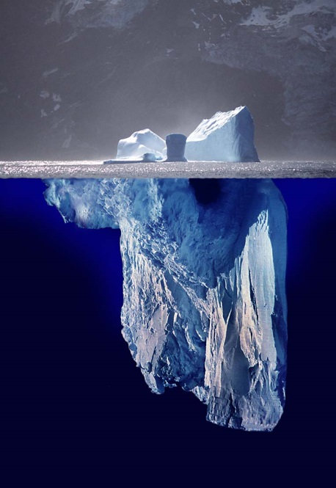
Questions?
This has been an executive-level briefing
For much more detailed information, contact your office’s POA BEFORE you hit the iceberg
NOAA Export Control Program
http://deemedexports.noaa.gov/
NOAA Policy NAO 207-12 “Technology Controls and Foreign National Access”
http://www.corporateservices.noaa.gov/ames/administrative_orders/chapter_207/207-12.html
NESDIS Export Control Policy
http://deemedexports.noaa.gov/roles_&_responsibilities/index.html
ITAR and EAR regulations
http://www.pmddtc.state.gov/regulations_laws/itar_official.html
http://www.bis.doc.gov/policiesandregulations/ear/index.htm

